Slide 1
Chapter 2
Physical Layer Cabling

Slide 2
Chapter Objective
Define horizontal cabling
Define UTP and STP
Define the categories of UTP cable
Describe the difference in the T568A and T568B wire color order

Slide 3
Chapter Objectives
Describe the procedure for placing RJ-45 plugs and jacks on twisted pair cable
Describe how to terminate twisted pair cable for computer networks
Define the basic concepts for planning a cable installation for an office LAN
Describe the procedure for certifying a twisted-pair cable
Describe the issue of 10G Ethernet over UTP

Slide 4
Physical Layer Cabling
This chapter examines the twisted-pair media used to link computers together to form a computer local area network. This is called physical layer cabling.
The term physical layer describes the media that interconnects networking devices.

Slide 5
EIA/TIA 568-B
in the year 2000 a new standard, the EIA/TIA 568-B was published. The three parts of the EIA/TIA 568-B are as follows:
EIA/TIA-568-B.1 Commercial Cabling
EIA/TIA-568-B.2 Twisted Pair Media
EIA/TIA-568-B.3 Optical Fiber Cabling

Slide 6
Horizontal Cabling
Permanent network cabling within a building is considered to be horizontal cabling
This is defined as the cabling that extends out from the telecommunications closet into the LAN work area.

Slide 7
Horizontal Cabling
Take time to plan for your horizontal cabling installation, this is where your network interfaces with the users.
There is always a substantial installation cost associated with horizontal cabling and there is an even greater cost of having to replace or upgrade a cable installation.
You don’t want to have re-cable your system very often.
Careful attention should be given to planning for the horizontal cabling of a LAN. Make sure that you fully understand your current networking needs and that your proposed plan meets the needs. Also, make sure your plan addresses future needs and growth of your network.

Slide 8
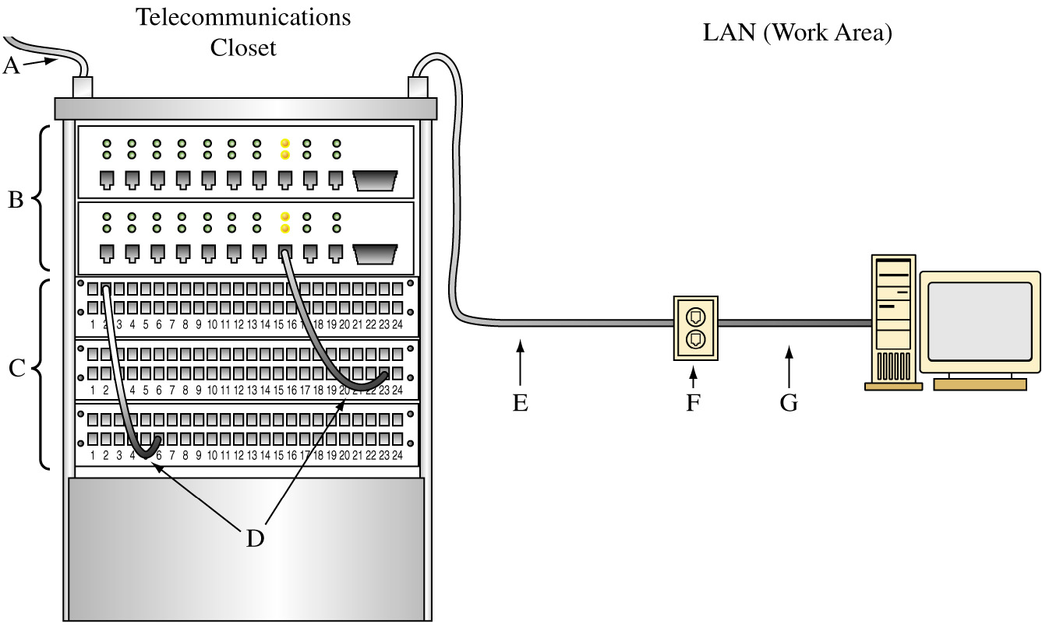
The Basic Blocks of Horizontal Cabling

Slide 9
The Basic Blocks of Horizontal Cabling
A. Backbone Cabling

Slide 10
The Basic Blocks of Horizontal Cabling
B. Switch or Hub

Slide 11
The Basic Blocks of Horizontal Cabling
C. Patch Panels

Slide 12
The Basic Blocks of Horizontal Cabling
D. Patch Cables

Slide 13
The Basic Blocks of Horizontal Cabling
E. Cabling to the LAN

Slide 14
The Basic Blocks of Horizontal Cabling
F. Wall Plate

Slide 15
The Basic Blocks of Horizontal Cabling
G. Patch cable connecting the computer to the wall plate

Slide 16
Unshielded Twisted-Pair Cable

Slide 17
UTP – Unshielded Twisted Pair
Unshielded twisted-pair (UTP) plays an important role in computer networking. The most common twisted-pair standards used for computer networking today are
category 5e (CAT5e)
category 6 (CAT6)
category 7 (CAT7)

Slide 18
CAT5/5e/6 Performance
CAT5e cable is an enhanced version of CAT5 that provides improved performance (1000 Mbps) requirements of the cable.
CAT6 cable provides improved data performance with 1000 Mbps and 250 MHz bandwidth [CAT6A has 500 MHz bandwidth]
CAT7 cable provides improved data performance with up to 10 Gbps and 600 MHz bandwidth.

Slide 19
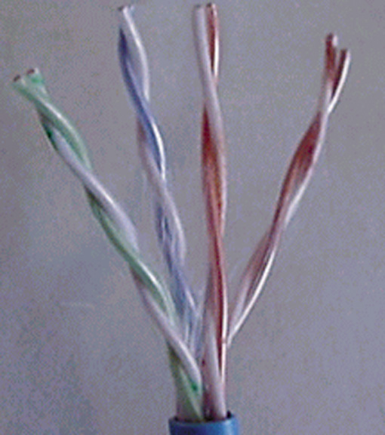
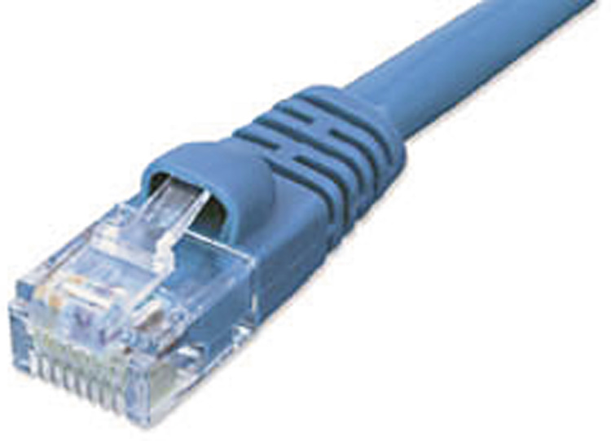
CAT5/5e/6 twisted-pair cable contain four color coded pairs
of 22- or 24-guage wires terminated with an RJ-45 connector.
An example of UTP cable terminated with an RJ-45 modular plug.

Slide 20
CAT5/5e/6 twisted-pair cable contain four color coded pairs
of 22- or 24-guage wires terminated with an RJ-45 connector.
An example of UTP cable terminated with an RJ-45 modular plug.

Slide 21
CAT5/5e/6 twisted-pair cable contain four color coded pairs
of 22- or 24-guage wires terminated with an RJ-45 connector.
An example of UTP cable terminated with an RJ-45 modular plug.

Slide 22
Cable Twists
The precise manner in which the twist of CAT5/5e cable is maintained, even at the terminations, provides a significant increase in signal transmission performance.
CAT5/5e standards allow 0.5 inches of untwisted connectors at the termination.
CAT6 allows for 3/8” of untwisted cable
The termination is the point where the cable is connected to terminals in either a modular plug, jack, or patch panel.

Slide 23
Balanced Mode of Operation
In twisted-pair cable, none of the wires in the wire pairs are connected to ground.
The signals on the wires are set up for a high(+) and low(-) signal line.
The (+) indicates that the phase relationship of the signal on the wire is positive.
The (-) indicates that the phase of the signal on the wire is negative, both signals are relative to a virtual ground.

Slide 24
Balanced Mode of Operation
This is called a balanced mode of operation.
In a balanced mode of operation, the balanced operation of the two wire pairs help to maintain the required level of performance in terms of crosstalk and noise rejection.

Slide 25
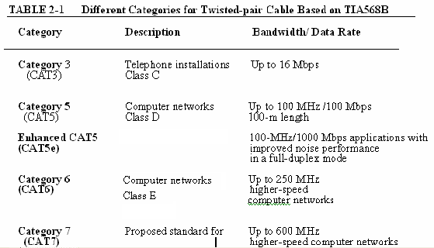
Twisted-Pair Categories

Slide 26
CAT5e Cabling
TIA/EIA ratified the CAT5e cabling specification in 1999 to address this continuing need for greater data handling capacity in the computer networks.
The enhanced CAT5 cable provides an improvement in cable performance and if all components of the cable installation are done according to specification then CAT5e will support full duplex gigabit Ethernet (1000 Mbps Ethernet) using all four wire pairs. Full duplex means that the computer system can transmit and receive at the same time.

Slide 27
CAT6 Cabling
TIA/EIA ratified the CAT6 cabling specification in June 2002.
This cable provides an even better performance specification and 250 MHz of bandwidth while maintaining backward compatibility with CAT5/5e

Slide 28
Shielded Twisted Pair (STP)
In some applications, a wire screen or metal foil shield is placed around the twisted-pair cable. Cable with the addition of a shield is called shielded twisted-pair cable (STP).
The addition of this shield reduces the potential for electromagnetic interference (EMI). EMI originates from devices such as motors, power lines, and some lighting devices such as fluorescent lights.
The shield on the twisted-pair cable does not reject all potentially interfering noise (EMI) but it does greatly reduce noise interference.

Slide 29
STP vs. UTP
There is an active debate in the networking community as to which product is superior, UTP or STP. It is important to note that the objective of both cables is to successfully transport data from the telecommunications closet to the work area.
Industry testing on STP cable has shown that the addition of a shield does increase the usable bandwidth of the cable by increasing the noise rejection between each of the wire pairs.

Slide 30
STP vs. UTP
However, the tests have shown that there is not a significant advantage of placing a shield over a properly installed 4-pair 100 ohm UTP cable.
Additionally, STP is more expensive and the increased costs may not justify the benefits.
For now, most manufacturers are recommending the use of UTP cable for cabling computer networks.

